Slide 1
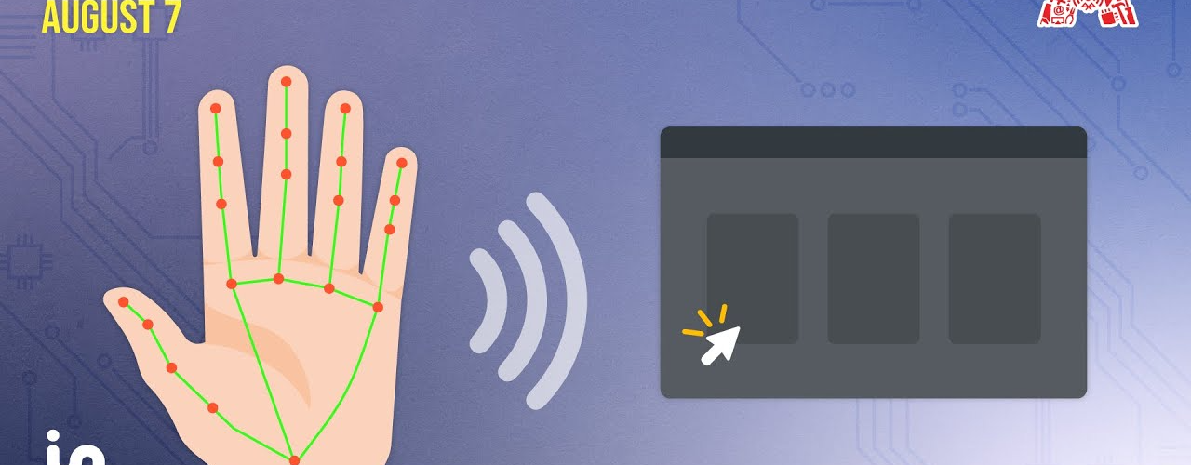
Virtual Mouse using OpenCV
Virtual mouse allows controlling mouse cursor using hand gestures

Slide 2




Introduction
Traditional devices have limitations
New methods enhance experience
Vision-based interaction emerging
Keyboards and mice restrict natural interactions
Alternative inputs like touch, voice, gestures improve accessibility and usability
Computer vision enables intuitive hands-free controls like virtual mouse
Alternative inputs are transforming interactions by enhancing experience and accessibility beyond traditional devices

Slide 3
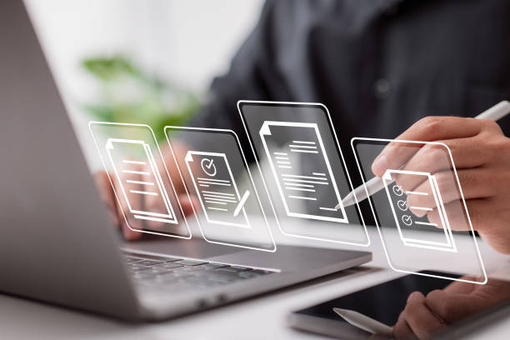
Methodology
Detect hand
Use OpenCV's hand detection algorithms to detect and segment the hand from the webcam video feed.
Track movements
Track the hand movements by analyzing the position of the hand across video frames.
Map to mouse
Map the tracked hand movements to corresponding mouse movements on screen using predefined rules.
Recognize gestures
Implement gesture recognition to detect actions like left click, right click, scrolling etc.

Slide 4


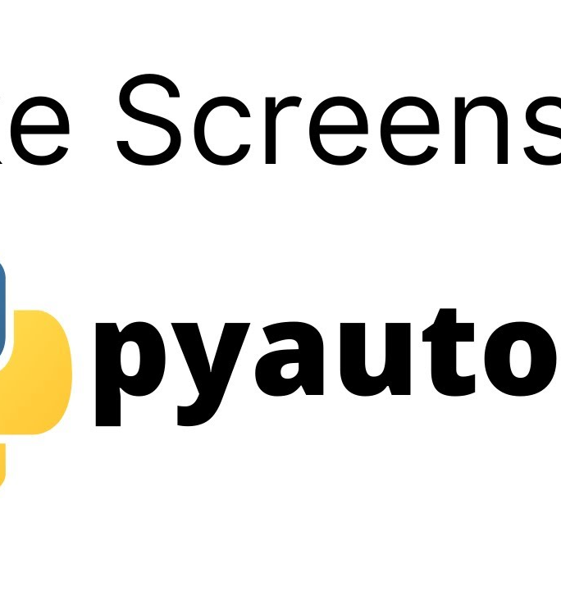
Libraries Used in the Mini Project
OpenCV
Mediapipe
PyAutoGUI
OpenCV provides computer vision
algorithms to detect and track
hands in real-time video.
Mediapipe offers robust hand tracking
capabilities to extract hand landmarks.
PyAutoGUI allows controlling mouse
and keyboard programmatically
based on hand movements.

Slide 5



Advantages
Hands-free control
Accessibility for disabled users
Natural interaction
Usable in presentations/exhibits

Slide 6

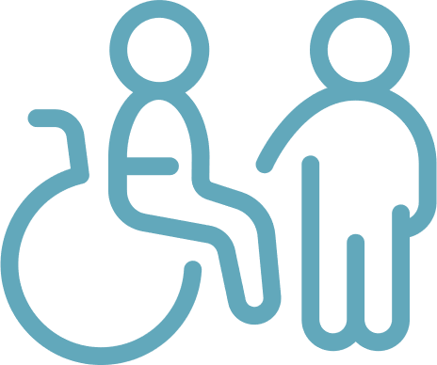


Code
Import OpenCV, Mediapipe, PyAutoGUI
Detect and track hand landmarks
Map hand movements to mouse cursor
Recognize gestures for clicking
Import necessary libraries for computer vision, hand tracking and controlling mouse cursor
Use OpenCV and Mediapipe to detect hand in webcam feed and track hand landmark coordinates
Translate hand landmark coordinates to mouse cursor positions on screen
Identify pinching gesture through thumb and index finger proximity to trigger mouse clicks
The code implements real-time hand tracking to control mouse cursor using OpenCV and Mediapipe. Hand landmark coordinates are mapped to cursor positions. Pinching gesture triggers mouse click.

Slide 7
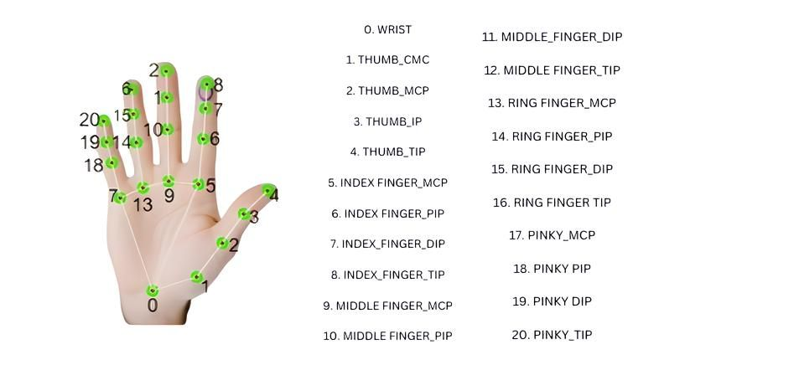

Slide 8
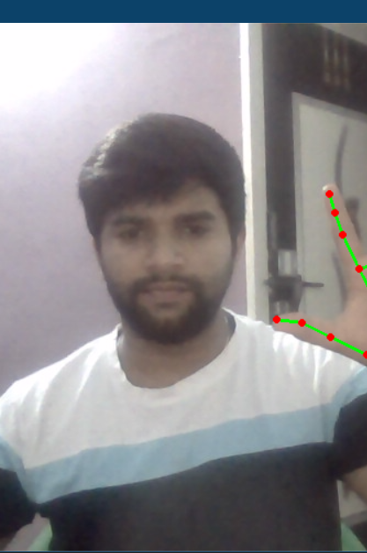
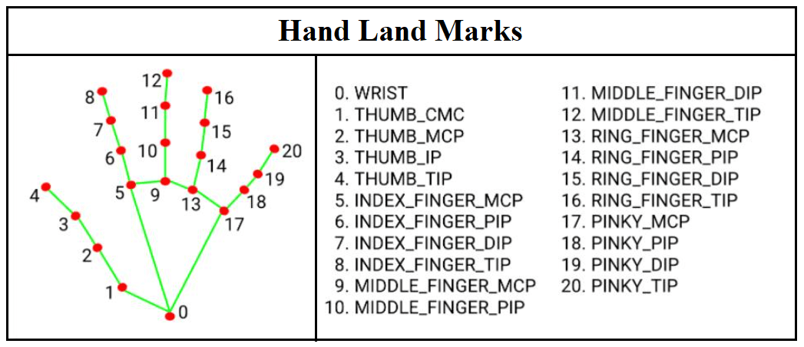
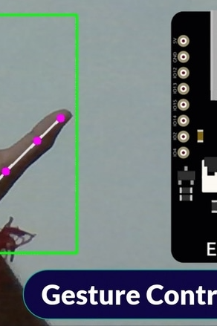
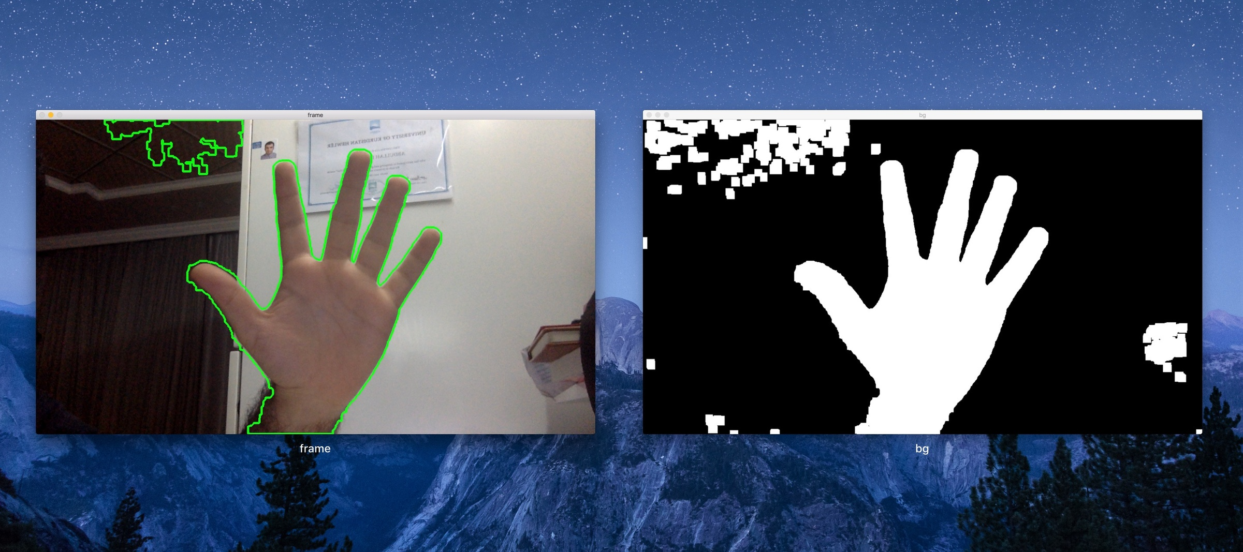
Output
Hand Detection
Hand Landmarking
Cursor Movement
Clicking Operation
Image showing hand detection on webcam feed
Image showing hand landmark detection
GIF showing cursor moving based on hand movement
GIF demonstrating mouse click based on hand gesture

Slide 9
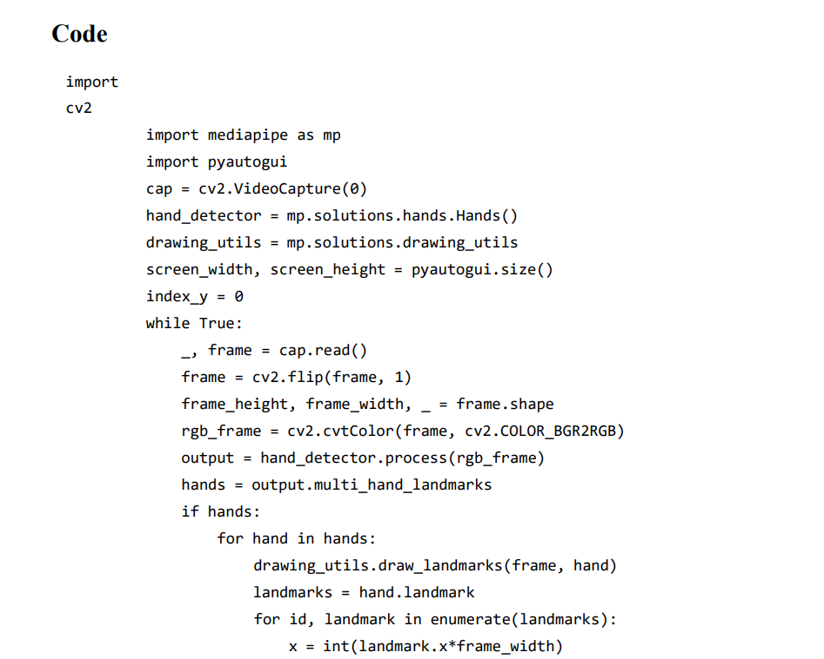
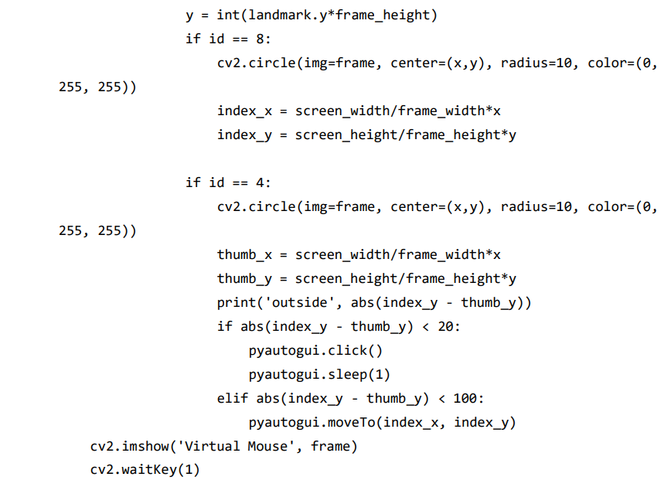

Slide 10
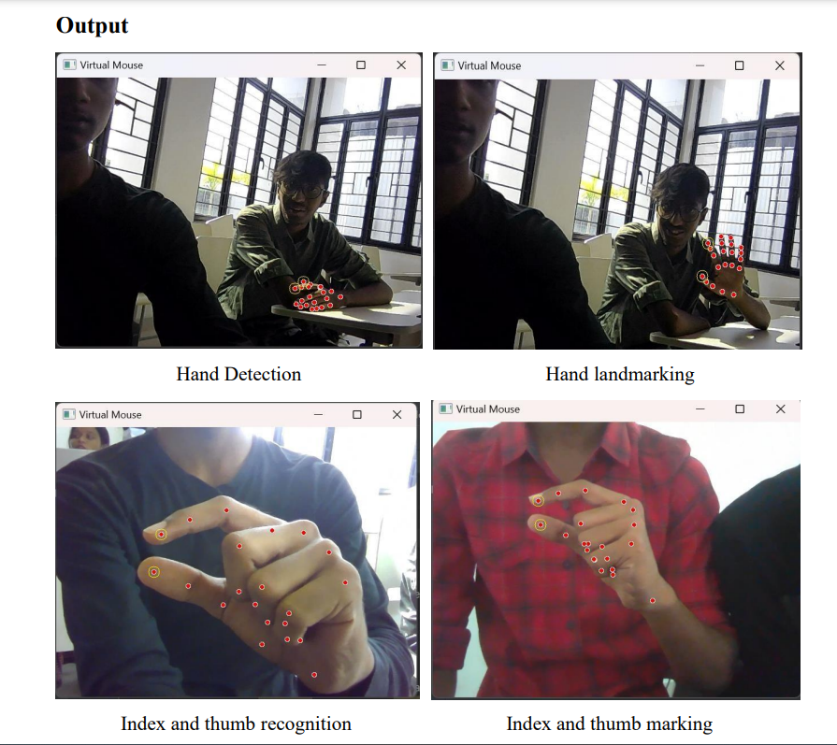

Slide 11
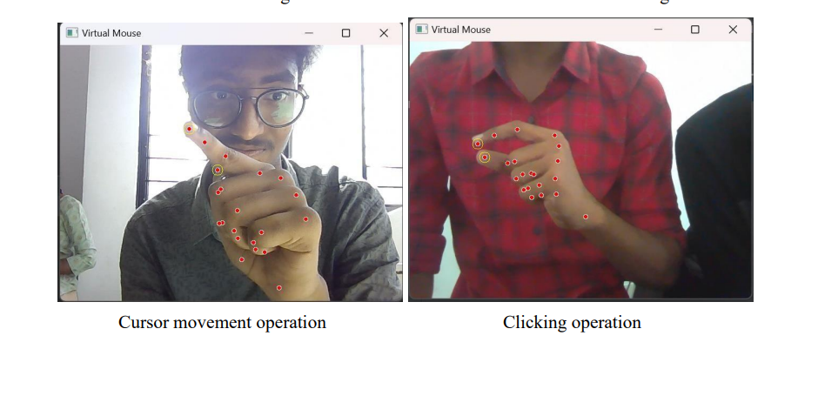

Slide 12
Conclusion
Feasibility of Gesture-Based Mouse
Intuitive Interaction
Enhancement Potential
Provides intuitive, hands-free way to interact with computer without physical mouse.
Opportunities exist to further improve accuracy and responsiveness of hand tracking.
Virtual Mouse prototype demonstrates feasibility of controlling mouse pointer using hand gestures and OpenCV.
Applications
Computer Vision
Future Work
Potential use cases include accessibility, gaming, interactive displays.
Project showcases power of computer vision in transforming human-computer interaction.
Extensions possible to support more gestures and actions for versatile interaction.

